Slide 1

Collaborative Filtering Approach For Book Recommendations Based On User Preferences
Britney Agius
Institute of Information & Communication Technology
MCAST, Paola, Malta

Slide 2
Problem Definition
The current book recommendation system lacks accuracy and relevance, failing to provide users with personalised and suitable book suggestions.
Users are often presented with book recommendations that do not align with their preferences, resulting in frustration and a subpar user experience.
The existing system does not effectively utilise collaborative filtering algorithms, which are known to enhance recommendation accuracy by leveraging user behaviour and preferences.
By integrating collaborative filtering algorithms and fine-tuning the recommendation system, it is possible to significantly improve the accuracy and relevance of book recommendations.

Slide 3
Literature
Topic: The topic of this research focuses on improving book recommendation systems by integrating collaborative filtering algorithms and fine-tuning the system, aiming to provide users with more accurate and personalised book suggestions.
Domain: The research is situated within the domain of recommender systems, specifically in the context of book recommendations. It explores the application of algorithms and approaches to analyse user activity, book metadata, and social networks to enhance the reading experience.
Relevant Theory: Collaborative filtering is a relevant theory in recommender systems, where personalised recommendations are generated based on user behaviour and preferences. This technique identifies patterns and similarities among users to suggest items that have been highly rated by users with similar tastes.

Slide 4
Literature
Sources: The literature review includes academic papers and scholarly articles as resources to gain insights into book recommendation systems and various algorithms like collaborative filtering.
Data: Commonly used datasets like Goodreads, Books, and Books Recommendations provide valuable resources for researchers studying book recommendation systems.
Algorithms: The research examines various algorithms in book recommendation systems, like collaborative filtering, content-based filtering, KNN, and hybrid approaches, to improve recommendation accuracy and relevance.
Results: Evaluation of book recommendation systems involves metrics like precision, recall, and F1-score, which assess recommendation accuracy, relevance, and effectiveness, aiding system optimisation and improvement.

Slide 5
Methodology – Aim, Hypothesis
Aim: Develop a book recommendation system using collaborative filtering techniques.
Hypothesis: By integrating collaborative filtering algorithms and fine-tuning the recommendation system, the accuracy and relevance of book recommendations can be increased, providing users with more personalised and suitable suggestions.

Slide 6
Methodology – Questions
Research Questions:
How does the integration of collaborative filtering algorithms improve the accuracy and relevance of book recommendations in the recommendation system?
What are the key factors that influence the effectiveness of collaborative filtering in a book recommendation system?
How can the recommendation system be fine-tuned to further enhance the accuracy and relevance of the book recommendations provided?
How can collaborative filtering algorithms be implemented to analyse user preferences and behaviours in the context of book recommendations?

Slide 7
Methodology – Pipeline
Load Data: Load various CSV datasets: Goodreads dataset, book id map dataset, and liked books dataset. Moreover, a JSON file containing book titles was also loaded.
Data Exploration: Check for null values and duplicate book records, and generate visualisations.
Transform and Clean Data: Eliminate null values and duplicates.
Data Splitting: Split the data into training and testing sets. In addition, use the training set to train the model and assess its performance on the test set.
Find Similar Users: Find similar users using cosine similarity and a sparse matrix.

Slide 8
Methodology – Pipeline
Rank Ratings: Rank ratings using an adjusted count considering book frequency among users with similar preferences.
Prediction: Generate personalised book recommendations for users.
Model Evaluation: Evaluate the accuracy of recommendations by comparing them to the liked books dataset using precision, recall, and F1 score metrics.

Slide 9
Methodology – Methods
Collaborative filtering is a technique used to provide personalised content by detecting patterns and similarities among users, recommending items that received high ratings from users with similar tastes.
The K-Nearest Neighbor (KNN) algorithm evaluates the proximity of items within a dataset and suggests preferred items of similar users to provide precise and personalised recommendations.
Collaborative filtering does not require explicit knowledge of item attributes, making it suitable when item definitions are challenging.
Both collaborative filtering and KNN leverage the similarity of user preferences to enhance recommendation accuracy and relevance.

Slide 10
Data Evaluation
Data for the book recommendation system was obtained through a tutorial on YouTube, providing a JSON file and three CSV files.
The book_titles.json file contained book information such as title, cover image URL, Goodreads URL, and number of ratings.
The good_interactions.csv file included over one million rows with user IDs, book IDs, ratings, book reviews, and read status, providing a comprehensive history of ratings for each user.
The liked_books.csv file was personalised with 105 rows of book titles, ratings, a fixed user ID, and book IDs.
The book_id_map.csv file contained over one million book IDs, facilitating data linkage across all files.

Slide 11
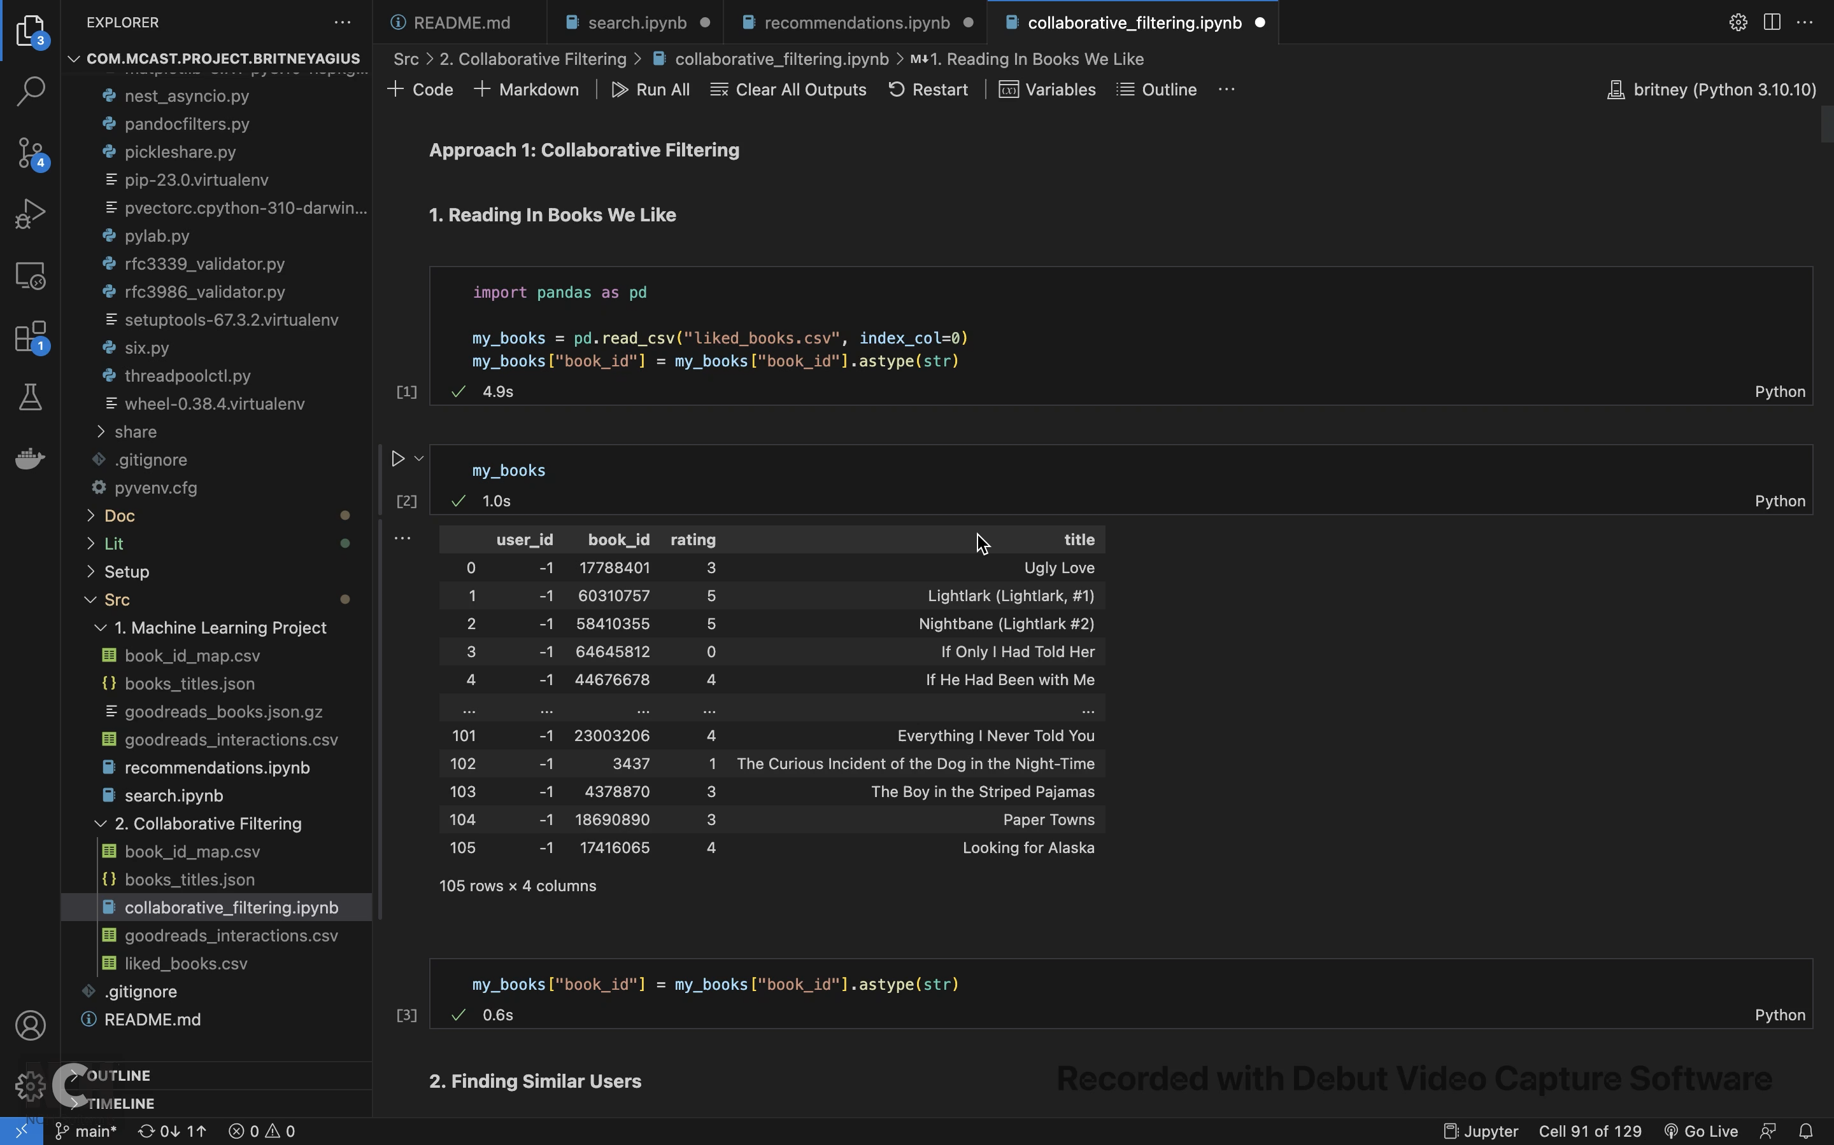
Prototype
Video Link: https://youtu.be/2bPitFmWiE8

Slide 12
Evaluation / Argumentation
The book recommendation system recommendations were evaluated using Evaluation Metrics.
The results were as follows:
The evaluation metrics of precision, recall, and F1-score for the book recommendation system were found to be 0.0, indicating an inaccurate assessment of the system's performance.
The obtained 0.0 values suggest that the evaluation metrics did not capture the accuracy and effectiveness of the recommendations appropriately.
 | My Research
Precision | 0.0
Recall | 0.0
F1-score | 0.0

Slide 13
3rd party comparison
A comparison was made with a research paper titled "A Research of Job Recommendation System Based on Collaborative Filtering" by Yingya Zhang, Cheng Yang, and Zhixiang Niu.
The research paper did not provide details on the data split ratio or dataset quality.
Evaluation metrics (precision, recall, and F1-score) were compared to assess the performance of the collaborative filtering algorithm used in the book recommendation system.
As highlighted in their study, they obtained a precision of 51.85, a recall of 48.28, and a F1-score of 50.00.
The comparative findings showcased the need for further research and improvements to achieve more accurate and effective model predictions in the book recommendation domain.

Slide 14
Pipeline evaluation
Strengths of the research pipeline: Successful implementation of collaborative filtering for book recommendations.
Limitations of the research pipeline: The Evaluation metrics resulted in 0.0 values, indicating inaccurate assessment, and the performance falls short compared to the referenced study.
Proposed improvements to address the limitations:
Incorporate a larger dataset for evaluation.
Explore alternative algorithms for book recommendations.
Optimize parameters to enhance system performance.

Slide 15
Research Question evaluation
RQ1: Collaborative filtering algorithms enhanced book recommendations by analysing similar users' preferences, resulting in more accurate and relevant suggestions.
RQ2: The effectiveness of collaborative filtering in the book recommendation system was evaluated by considering key factors, including data quality, cosine similarity, user-base diversity, filtering thresholds, and integration of book metadata.

Slide 16
Research Question evaluation
RQ3: The recommendation system was fine-tuned to improve accuracy and relevance through refined user similarity measures, additional collaborative filtering techniques, and optimization using evaluation metrics such as precision, recall, and F1-score.
RQ4: Collaborative filtering algorithms were successfully implemented in the book recommendation system, leveraging user data to identify similar users and provide personalised recommendations based on preferences and behaviours.

Slide 17
Conclusions - Achievements
Successful integration of collaborative filtering algorithms in a book recommendation system.
Achieved aim and objectives:
Created a book recommendation system.
Collected /pre-processed Goodreads dataset and other datasets.
Implemented collaborative filtering.

Slide 18
Conclusions - Recommendations
Consider refining pre-processing methods for better data quality.
Explore advanced techniques to further improve system performance.

Slide 19
Conclusions - Limitations
Evaluation metrics indicate subpar performance of the system.
Further fine-tuning is necessary to improve system performance.

Slide 20
Future Recommendations
Enhance data collection by incorporating additional sources and refining pre-processing methods.
Explore advanced collaborative filtering techniques, such as matrix factorisation or deep learning approaches.
Investigate hybrid recommendation approaches combining collaborative filtering with content-based filtering.
Conduct user studies and incorporate feedback to validate and fine-tune the system.

Slide 21
Thank you Britney Agius

